Slide 1
Binary Tree Representations (Array)
An array can be used to store the nodes of a binary tree .
The nodes stored in an array of memory can be accessed sequentially.
Consider a binary tree T of depth d.
  Then at most 2^{d} – 1 nodes can be there in T.
  (i.e. SIZE = 2^{d}–1) So the array of size “SIZE” to represent the binary tree.
Consider a binary tree in Fig. below of depth 3.
  Then SIZE = 2³ – 1 = 7.
  Then the array A[7] is declared to hold the nodes.

Slide 2
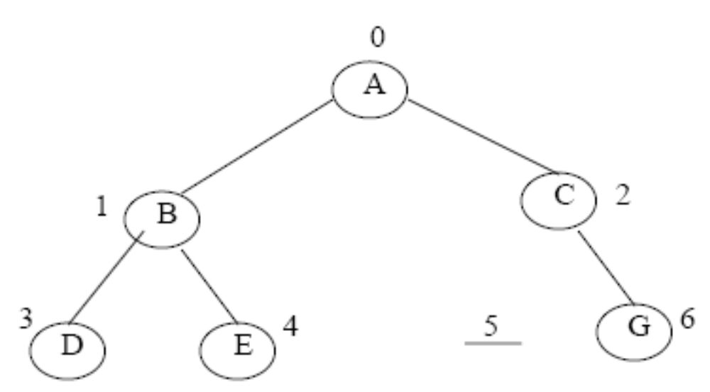
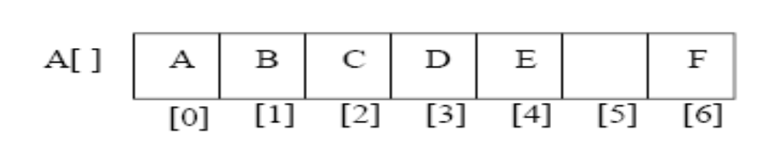
Binary Tree of Depth 3

Slide 3
To perform any operation often we have to identify the father, the left child and right child of an arbitrary node.
The father of a node having index n can be obtained by (n – 1)/2. For example to find the father of D, where array index n = 3. Then the father nodes index can be obtained
= (n – 1)/2
= 3 – 1/2
= 2/2
= 1 (i.e. father of D is B at index 1)
The left child of a node having index n can be obtained by (2n+1). For example to find the left child of C, where array index n = 2. Then it can be obtained by
= (2n +1)
= 2*2 + 1
= 4 + 1
= 5 (i.e. left child of C is F at index 5)

Slide 4
The right child of a node having array index n can be obtained by the formula (2n + 2). For example to find the right child of B, where the array index n = 1. Then
= (2n + 2)
= 2*1 + 2
= 4 (i.e. right child of B is E at index 4)
If the left child is at array index n, then its right brother is at (n + 1). Similarly, if the right child is at index n, then its left brother is at (n – 1).
The array representation is more ideal for the complete binary tree. In case of incomplete binary tree there is memory wastage as memory allocated to even if there is no left or right child of the non-terminal nodes.

Slide 5
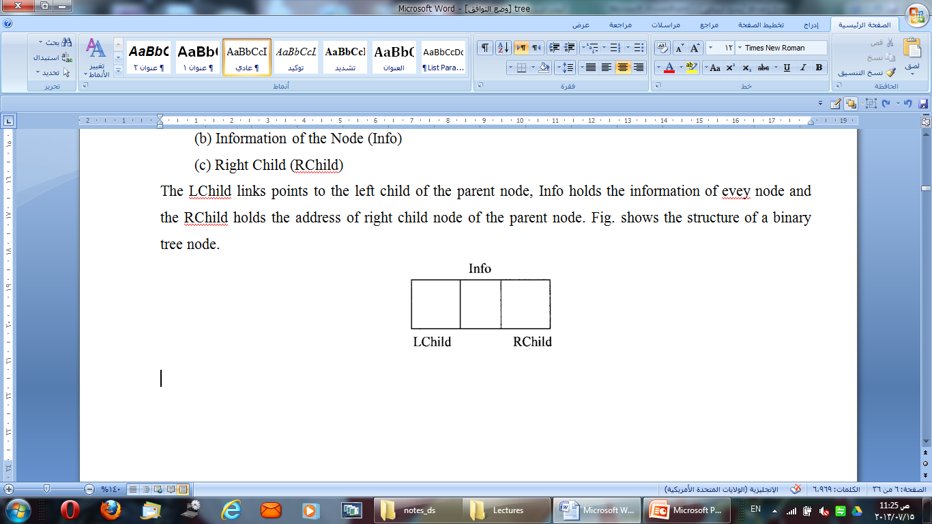
Linked List Representation ( B Tree )
The most popular and practical way of representing a binary tree is using linked list (or pointers). In linked list, every element is represented as nodes. A node consists of three fields such as :
(a) Left Child (LChild)
(b) Information of the Node (Info)
(c) Right Child (RChild)
The LChild links points to the left child of the parent node, Info holds the information of evey node and the RChild holds the address of right child node of the parent node. Fig. shows the structure of a binary tree node.

Slide 6
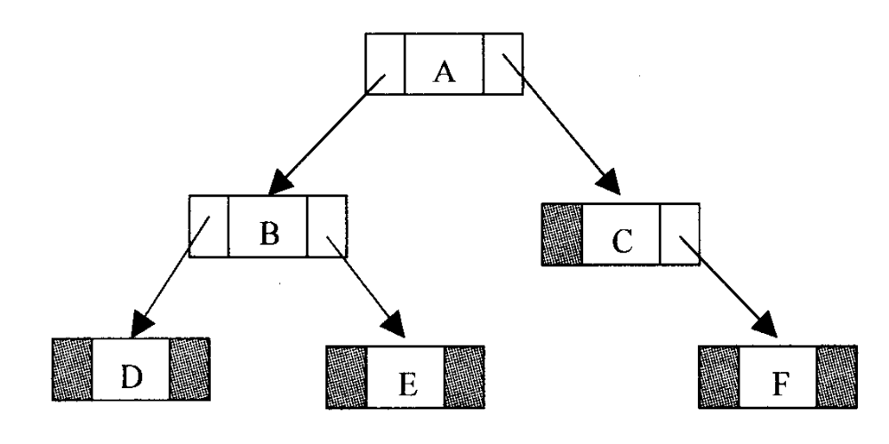
Binary Tree Representations (Linked List)
If a node has no left or / and right node, corresponding LChild or RChild is assigned to NULL

Slide 7
Structural Definition of Binary Trees
A binary tree is either empty or it has 3 parts:
    a value
    a left subtree
    a right subtree
Every node in a Binary tree has a structure like this -
struct NODE
{
struct NODE *leftchild;
int nodevalue; /*this can be of any type*/
struct NODE *rightchild;
};
The 'leftchild' and 'rightchild' are pointers to another tree-node. The "leafnode" will have NULL values for these pointers.

Slide 8
Properties and Application Of B tree
Properties of a Binary Tree:
* Each internal node has two children
* The children of a node are an ordered pair.
The children of an internal node is referred to as right child and left child.
Maximum number of nodes on level I of a binary tree is 2^{i-1} , i>=1
Applications
  Arithmetic Expressions
  Decision Process
  Searching

Slide 9
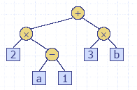
Arithmetic Expression Tree
In a binary tree associated with an arithmetic expression
  The internal nodes : operators
  The externals nodes: operands.
  Example : Arithmetic Expression Tree for the expression
  (2 * ( a – 1 ) + ( 3 * b ) )

Slide 10
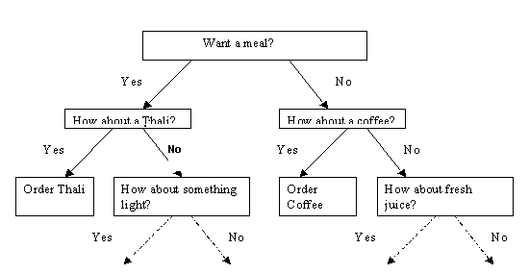
Decision Tree
In a binary tree associated with a decision process
  The internal nodes : questions with yes/ no answers
  The externals nodes: decisions.
  Example: Dining Decision

Slide 11
Tree Traversal
Traversing a data structure: to process every node exactly once.
To traverse a binary tree, do the following steps in some order:
(L) traverse the left subtree.
(R) traverse the right subtree.
(N) process the node itself.

Slide 12
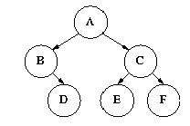
Tree Traversal Contd..
Inorder Traversal: (1) Traverse the left subtree (L).
(2) Process the node (N).
(3) Traverse the right subtree (R).
Traversing Binary Trees
Pre-Order Traversal: (1) Process the node (N).
(2) Traverse the left subtree (L).
(3) Traverse the right subtree (R).
Postorder Traversal: (1) Traverse the left subtree (L).
(2) Traverse the right subtree (R).
(3) Process the node (N).
From the figure, we know that
Inorder : B D A E C F
Preorder : A B D C E F
Postorder : D B E F C A

Slide 13
Recursive implementation for INORDER traversal.
C ++ implementation:-
struct NODE {
struct NODE *left;
int value;
struct NODE *right;
};
inorder(struct NODE *curr) {
if(curr->left != NULL) inorder(curr->left); /*step-1 & step-2*/
cout<< curr->value ; /*step-3*/
if(curr->right != NULL) inorder(curr->right); /*step-4*/

Slide 14
Pre-Order Traversal Recursively
C ++ Implementation:-
struct NODE
{
struct NODE *left;
int value;
struct NODE *right;
};
Preorder(struct NODE *curr)
{
Cout << curr->value ;
if(curr->left != NULL) Preorder(curr->left);
if(curr->right != NULL) Preorder(curr->right);
}

Slide 15
Post-Order Traversal Recursively
C ++ Implementation:-
struct NODE
{
struct NODE *left;
int value;
struct NODE *right;
};
Preorder(struct NODE *curr)
{
if(curr->left != NULL) Preorder(curr->left);
if(curr->right != NULL) Preorder(curr->right);
Cout << curr->value ;
}

Slide 16
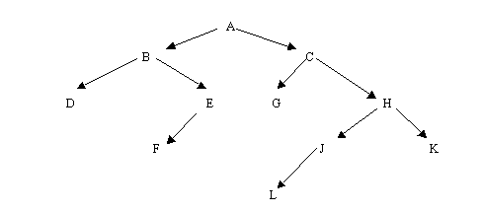
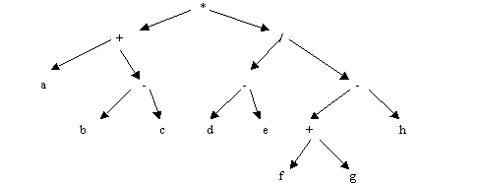
Exercise
Find the preorder, post order and in order traversals for the following trees
(1)
(2)

